Slide 1
Westfield Insurance Group
Defense Days Summit 2025
Jeanne Walker​
Vice President and Special Counsel​
US Chamber Institute for Legal Reform

Slide 2
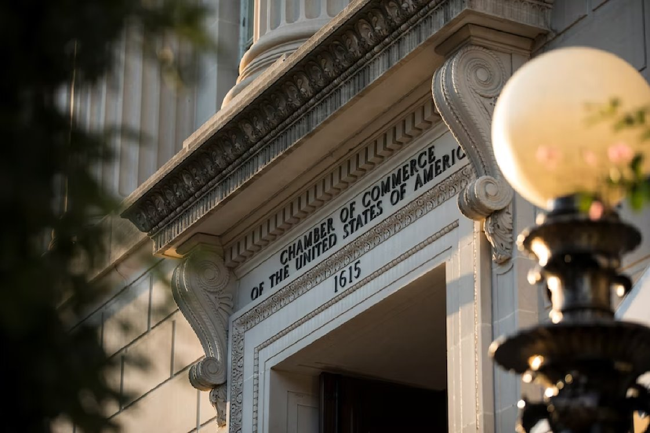
Who We Are
ILR is the most experienced, influential, and successful advocate for civil justice reform, both in the U.S. and abroad.
What We Do
Advocacy
Communications
Research, Data, and Tools
Voter Education
1
Notes:
**JW to transition into NVs —
Why do they matter?
Higher costs for consumers
Insurability problems for businesses
Unreasonable demands for settlements
Prolonged litigation and loss of confidence in the legal system
Current legislative trends — wrong direction
Expansions of state wrongful death acts
Expansions of statutes of limitations

Slide 3
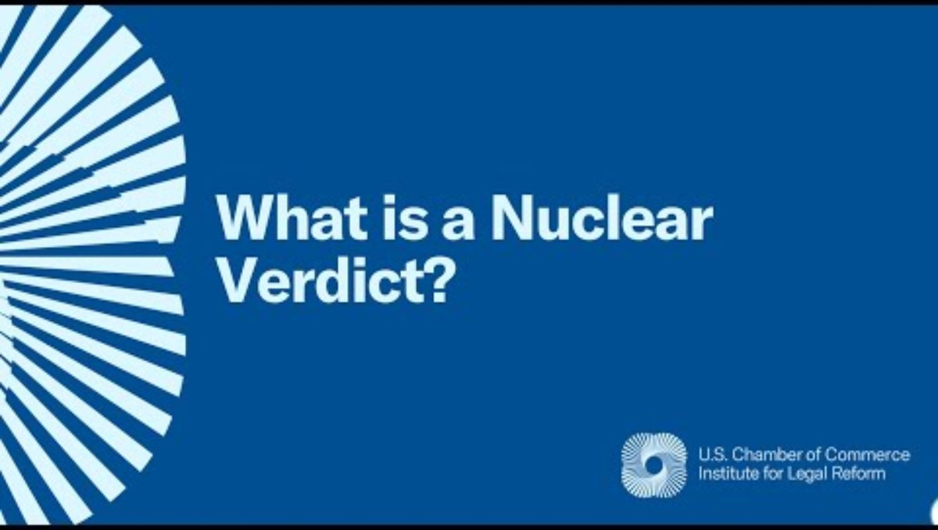

Slide 4
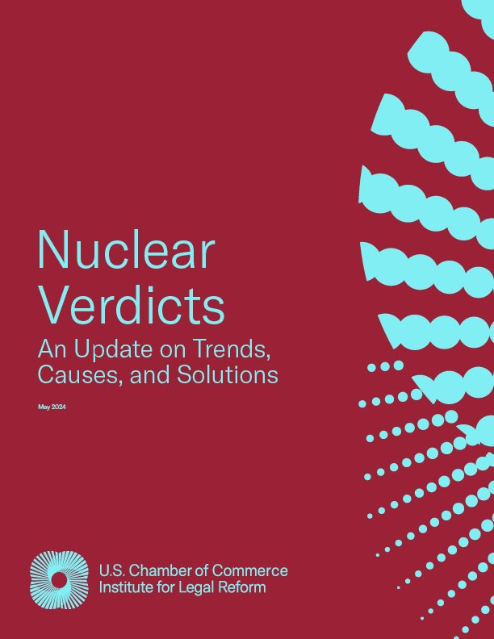
Nuclear Verdicts
2024 ILR Research Report
Cases with verdicts exceeding $10 million
Includes product liability, auto accidents, medical liability
2024 ILR Nuclear Verdicts Research Report:
    Surveyed 1,288 cases from 2013 to 2022
    115 "mega" nuclear verdicts, each exceeding $100 million
3

Slide 5
Nuclear Verdicts
Lovell v. Johnson & Johnson
Massachusetts Superior Court (Boston)
69-year-old plaintiff sued alleging that his mesothelioma was caused by asbestos in baby powder
Boston jury awarded: $42.6M
  $24 million for past and future pain and suffering
  $2.6 for past and future medical expenses
  $16 million to plaintiff's spouse for past and future loss of consortium
4

Slide 6
Nuclear Verdicts
Gill v. ExxonMobil et al. (2024)
Pennsylvania Court of Common Pleas (Philadelphia)
Former mechanic at gas station claimed exposure to benzene in Exxon Mobil products caused cancer (AML)
Exxon held liable for Failure to Warn
Exxon ordered to pay: $815M
  $725 million in compensation
  $90 million in delay damages
5

Slide 7
Nuclear Verdicts
Cooper v. Longwood Forest Products, Inc.(2023)
Federal Court for Southern District of Ohio
2-year-old child died from falling on a bunk bed ladder
Wayfair & Importer settled before trial; only defendant manufacturer
Jury awarded: $787M
    $522 million in punitive damages
    $175 million in delay damages
    $90 million in compensatory damages
6

Slide 8
Test Your Knowledge
Median cost of a Nuclear Verdict 2013-2022?
$11 million
$15 million
$21 million
$17 million
7

Slide 9
Test Your Knowledge
Median cost of a Nuclear Verdict 2013-2022?
C. $21 million
8

Slide 10
Test Your Knowledge
Mean cost of a Nuclear Verdict 2013-2022?
$57 million
$73 million
$89 million
$81 million
9

Slide 11
Test Your Knowledge
Mean cost of a Nuclear Verdict 2013-2022?
C. $89 million (that's one mean number)
10

Slide 12
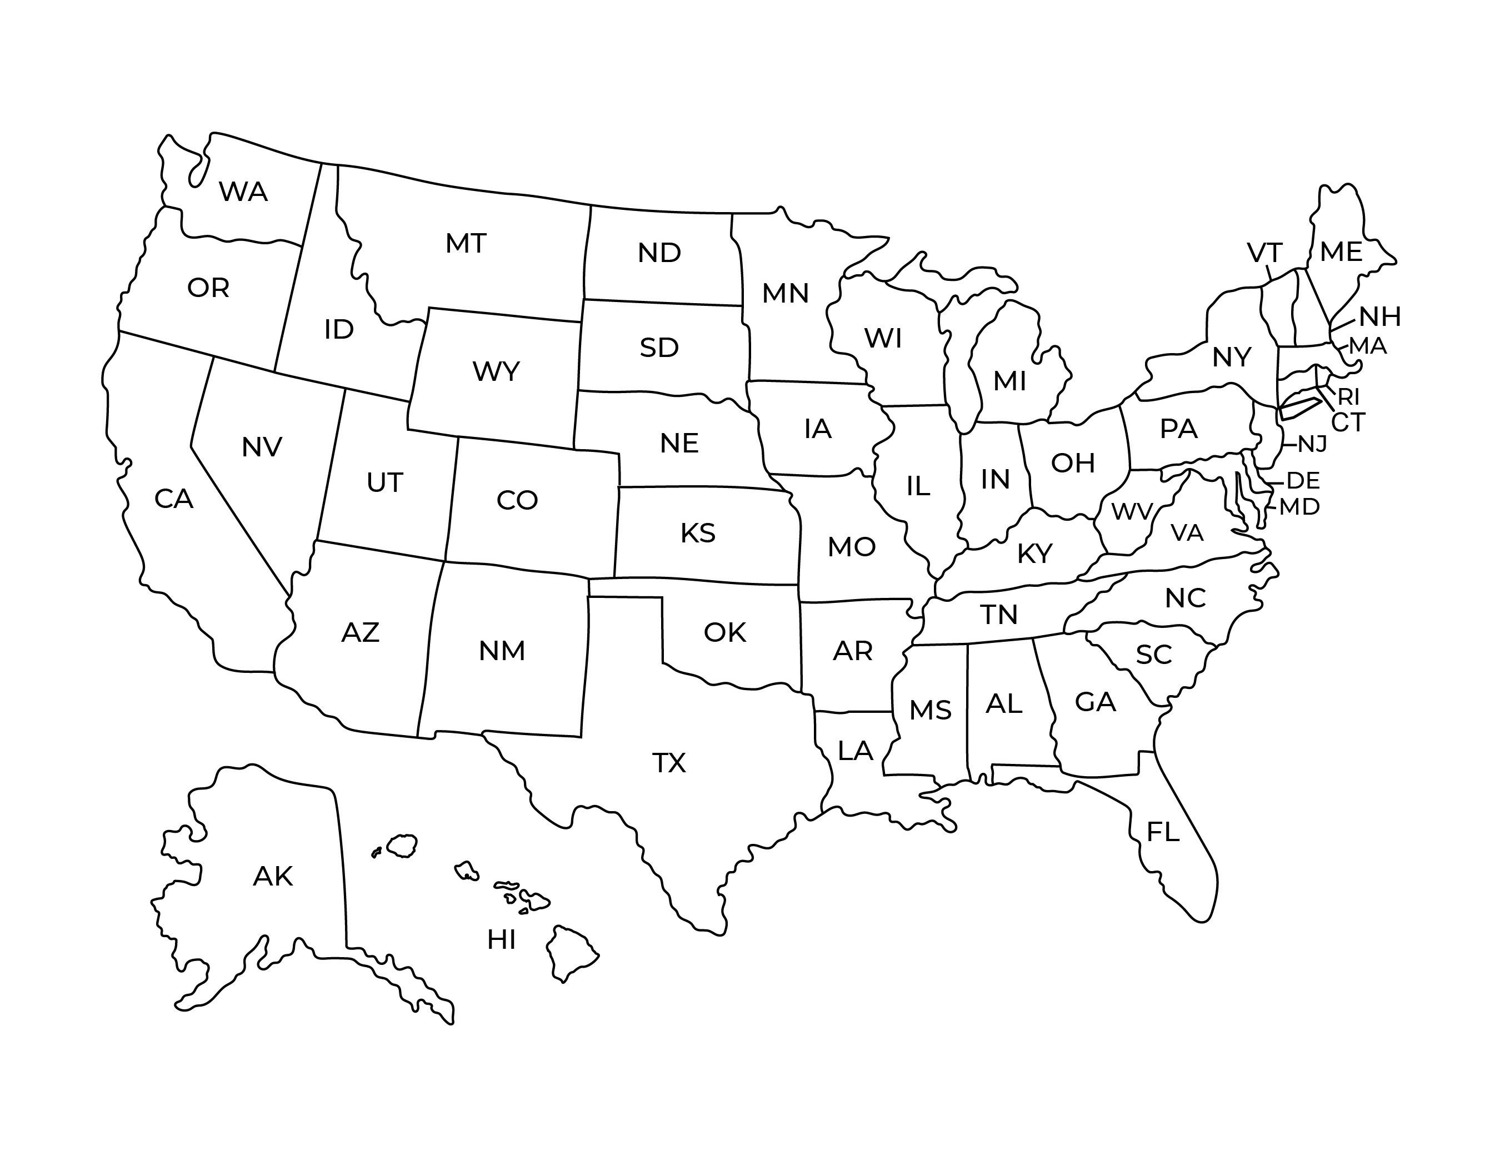
Test Your Knowledge
Which states have the highest number of nuclear verdicts?
11

Slide 13
Top 10 States for Nuclear Verdicts
These states account for half of the nation’s nuclear verdicts, despite representing only one-third of the U.S. population.
California
Florida
New York
Texas
Georgia
Illinois
Pennsylvania
Washington
Missouri
Ohio
12

Slide 14
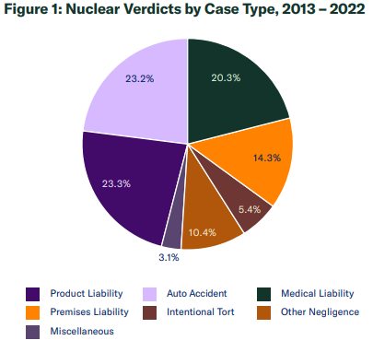
Nuclear Verdicts Breakdown
13

Slide 15
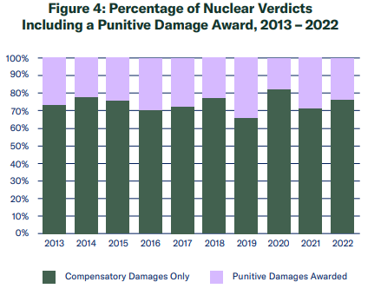
Don't Blame Punitive Damages
74% of the damages in the study were composed ENTIRELY of compensatory damages
14

Slide 16
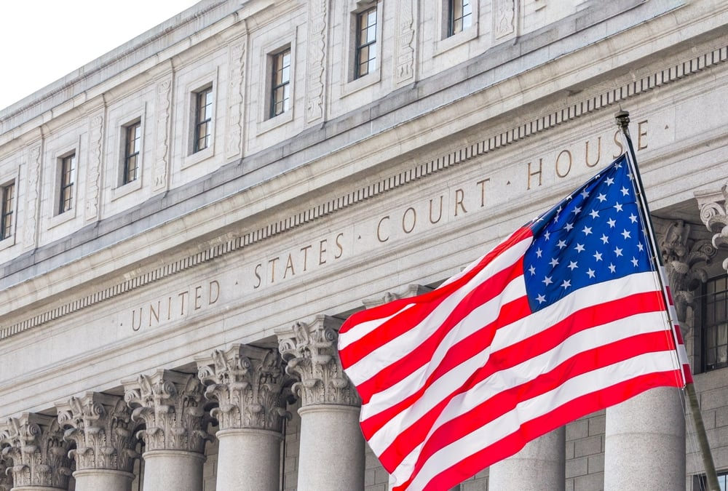
Federal Court Security
State courts more likely to see Nuclear Verdicts
  States hosted 9 out of 10 personal injury nuclear verdicts
Federal courts:
  Toss frivolous cases sooner
  Apply strict evidentiary standards
  Limit opportunities for venue shopping
  Have juries drawn from broader areas
15

Slide 17

Why is this happening?
16

Slide 18
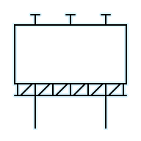





Nuclear Verdicts Drivers
Flawed Legal System
Plaintiff’s Bar Tactics
Legal Ads
TPLF
17

Slide 19


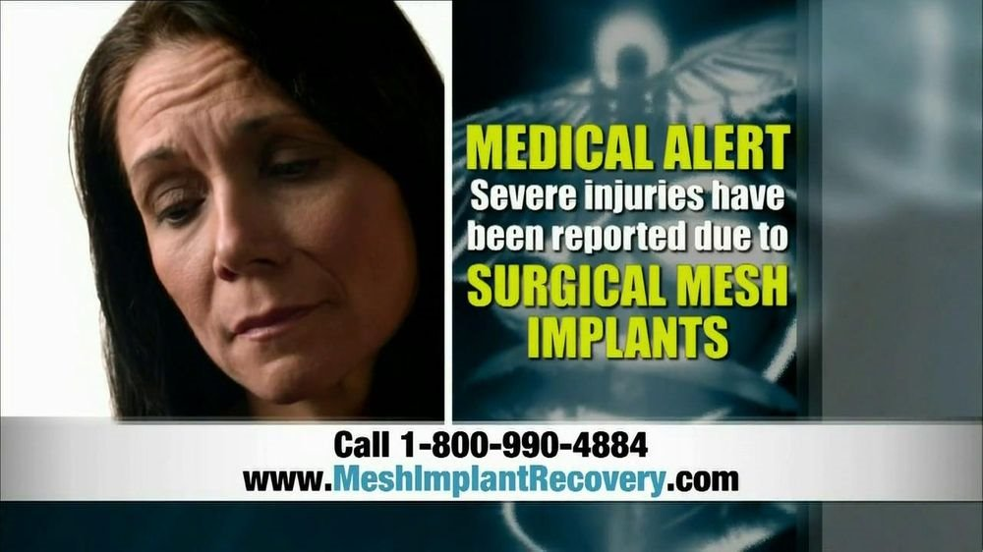
Trial Lawyer Advertising
18

Slide 20
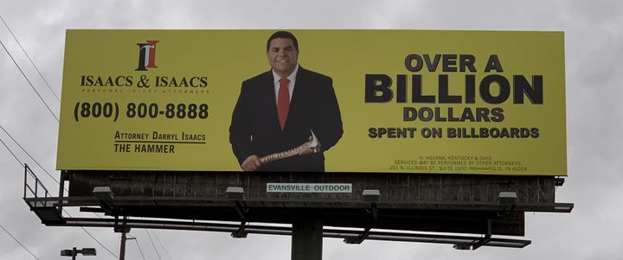
Trial Lawyer Advertising
Between Jan 2023 and June 2025
  $845 million on digital ads
  $3.37 billion on TV ads
Ad Content mostly unregulated
  "Medical Alerts"
  "You or a loved one may be entitled to compensation...“
Spurs pursuit of frivolous claims
Conditions jurors to award large verdicts
19
Notes:
Input board casting spend from Nick (study from 2023)

Slide 21
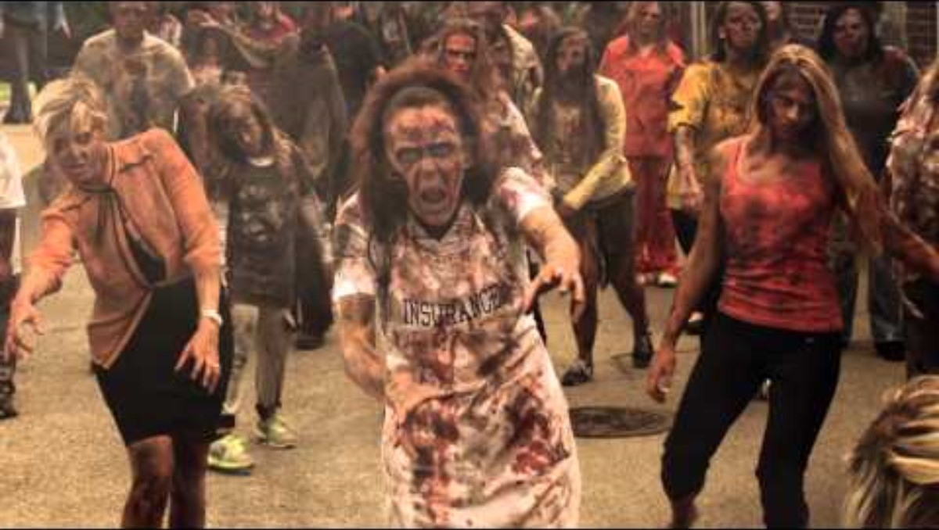

Slide 22

Third-Party Litigation Funding
21

Slide 23
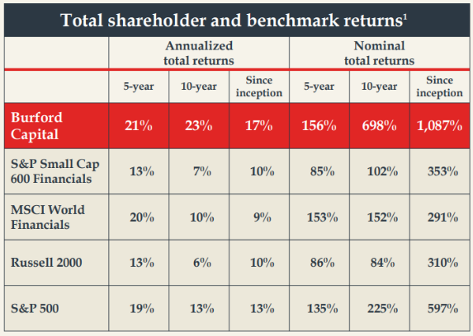
Third-Party Litigation Funding
Outside financiers invest in lawsuits in return for a percentage of the award, judgment or settlement
$16 billion "assets under management" in U.S. Lawsuits in 2024
"We make it harder and more expensive to settle cases" —Allison Chock, Chief Investment Officer, Bentham IMF, WSJ interview, 2018
(Almost) totally unregulated industry
22

Slide 24
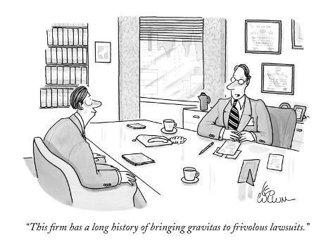
Trial Bar Tactics
23

Slide 25


Reptile Theory
Bias jurors with anger and fear!
Appeal to jurors' "reptilian brain" with anger​
Make jurors feel the defendant is a threat​
Punish corporations; not facts of case
Used in 67% of Nuclear Verdicts​
Results in an average increase in verdicts of 111%!!!​
24

Slide 26
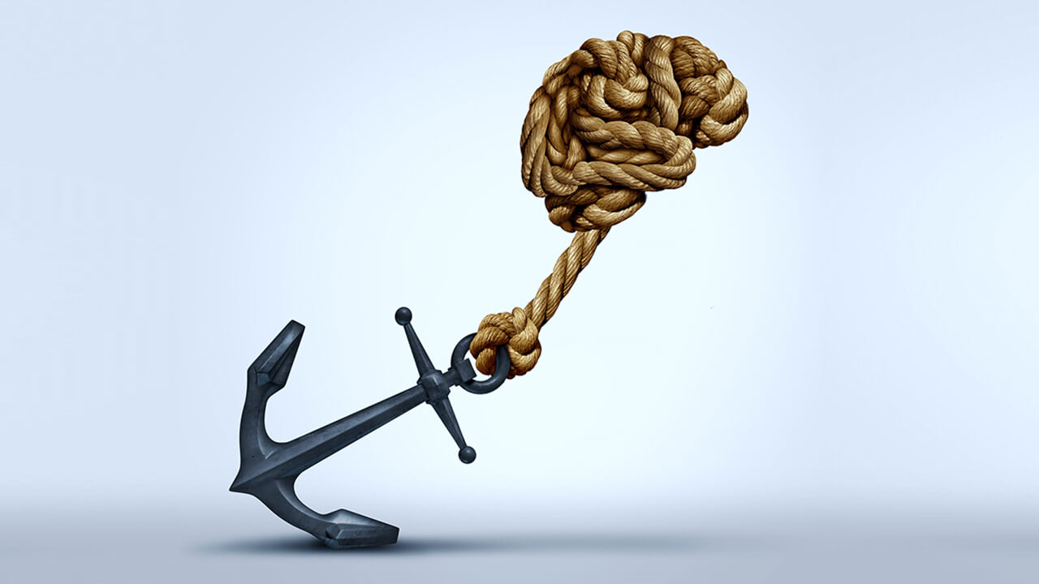
Jury Anchoring
Bias jurors' minds towards huge verdicts
Request an unreasonable award from the jury to create a "baseline" for what’s “fair”
Drop an "anchor" during jury selection
  "Would $10 million for 10 years of suffering be reasonable to you?"
Emotional appeals during opening and closing statements
  "$10 million is only fair—it's $1 million for every year she has lived with this pain!"
25

Slide 27
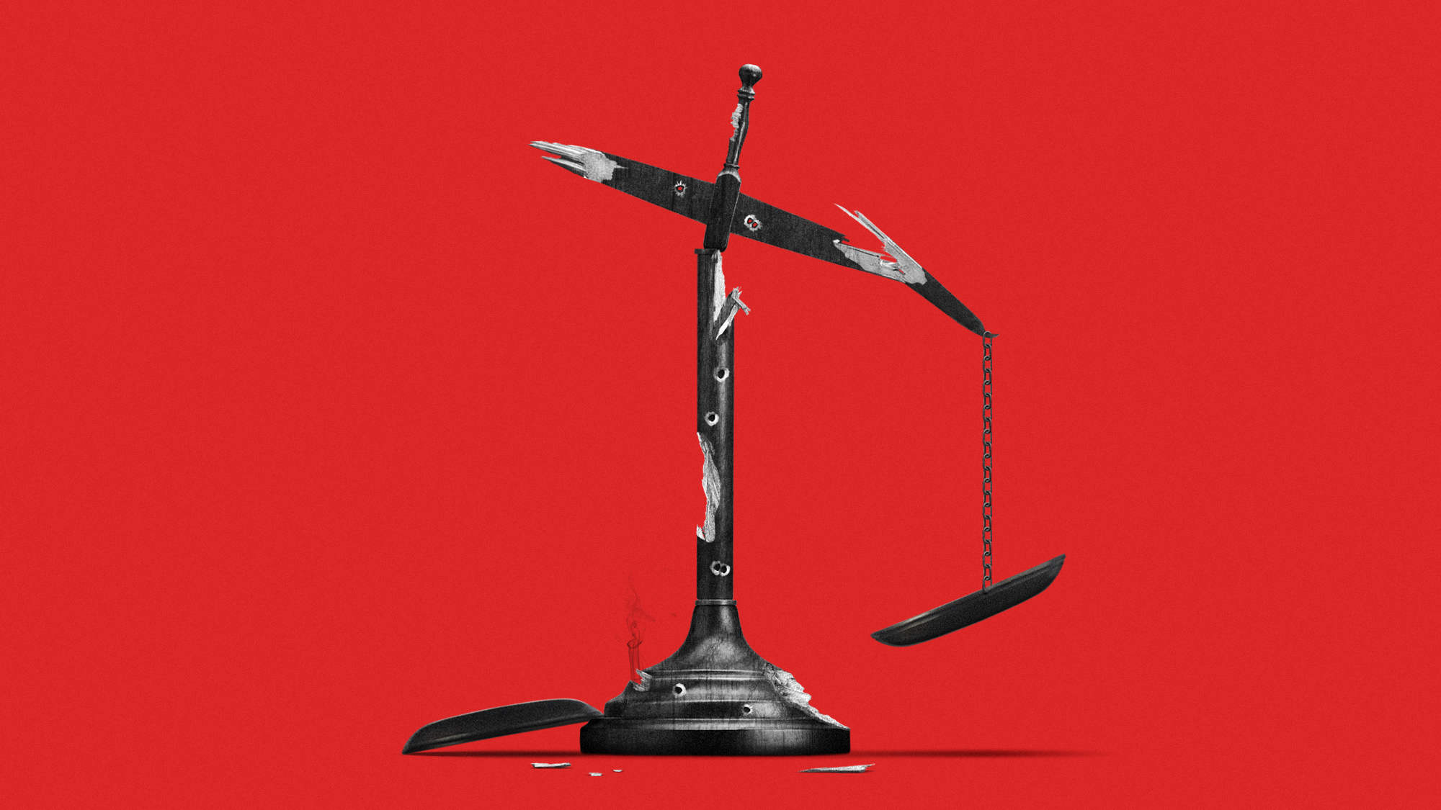
Flawed Legal System
26

Slide 28
Examples
Junk science in the courtroom
Inappropriate trial consolidation (composite plaintiffs)
Failure to bifurcate liability from damages at trial
​
No limits on damage awards for non-economic
Personal jurisdiction expansion and forum/venue shopping​
​
Expansion of state wrongful death acts​
​
Statutes of limitations expansion
27

Slide 29

Why Do We Care?
Bankrupts businesses
Higher costs for consumers
Unaffordable insurance
Prolonged litigation
Undermines the rule of law
28

Slide 30
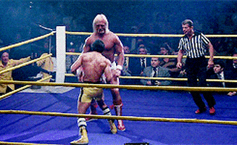
Punching Back on Nuclear Verdicts
29

Slide 31

ILR Toolkit—101 Ways
Restrict lawsuit advertising
Adopt TPLF reforms
Bifurcate liability and damages at trial
Bar anchoring during trial
Stricter venue and jurisdictional laws
Establish limits on noneconomic and punitive damages
Bar "junk science" from the courtroom
30

Slide 32
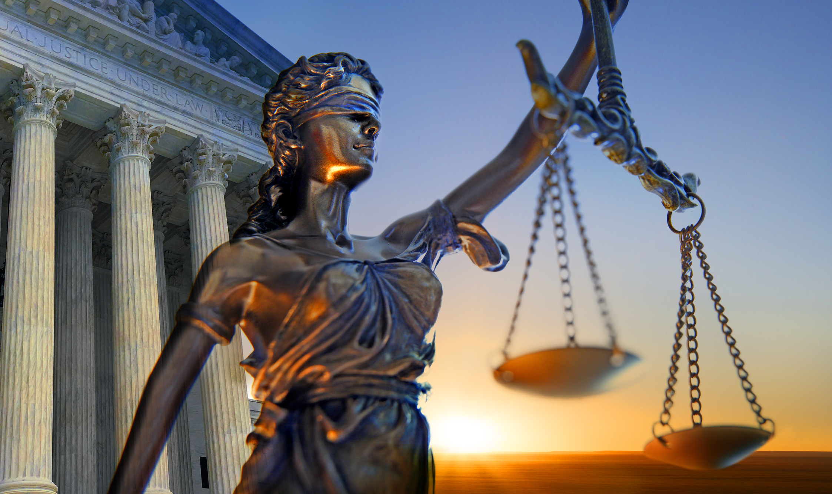
ILR's Advocacy in 2025
Passed TPLF reform bills in 7 states
Broad tort reform packages in Georgia and Oklahoma
Amended Montana's public nuisance law
Comparative fault and damage transparency in Louisiana
Rule 702 reform proposals e.g. Texas, Missouri and Oklahoma
Blocked attempts to roll back Florida's prior tort reform package
Killed climate-change retroactive penalties bills in over 10 states
31

Slide 33
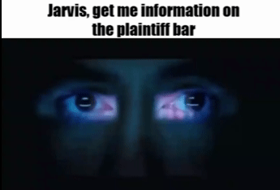
Looking ahead….
Artificial Intelligence (LLMs)
32
Notes:
Finding established patterns in mass tort claim
Predictive modeling for case valuation/strategy
Identifying more sympathetic jurisdictions a conversation style.

Slide 34
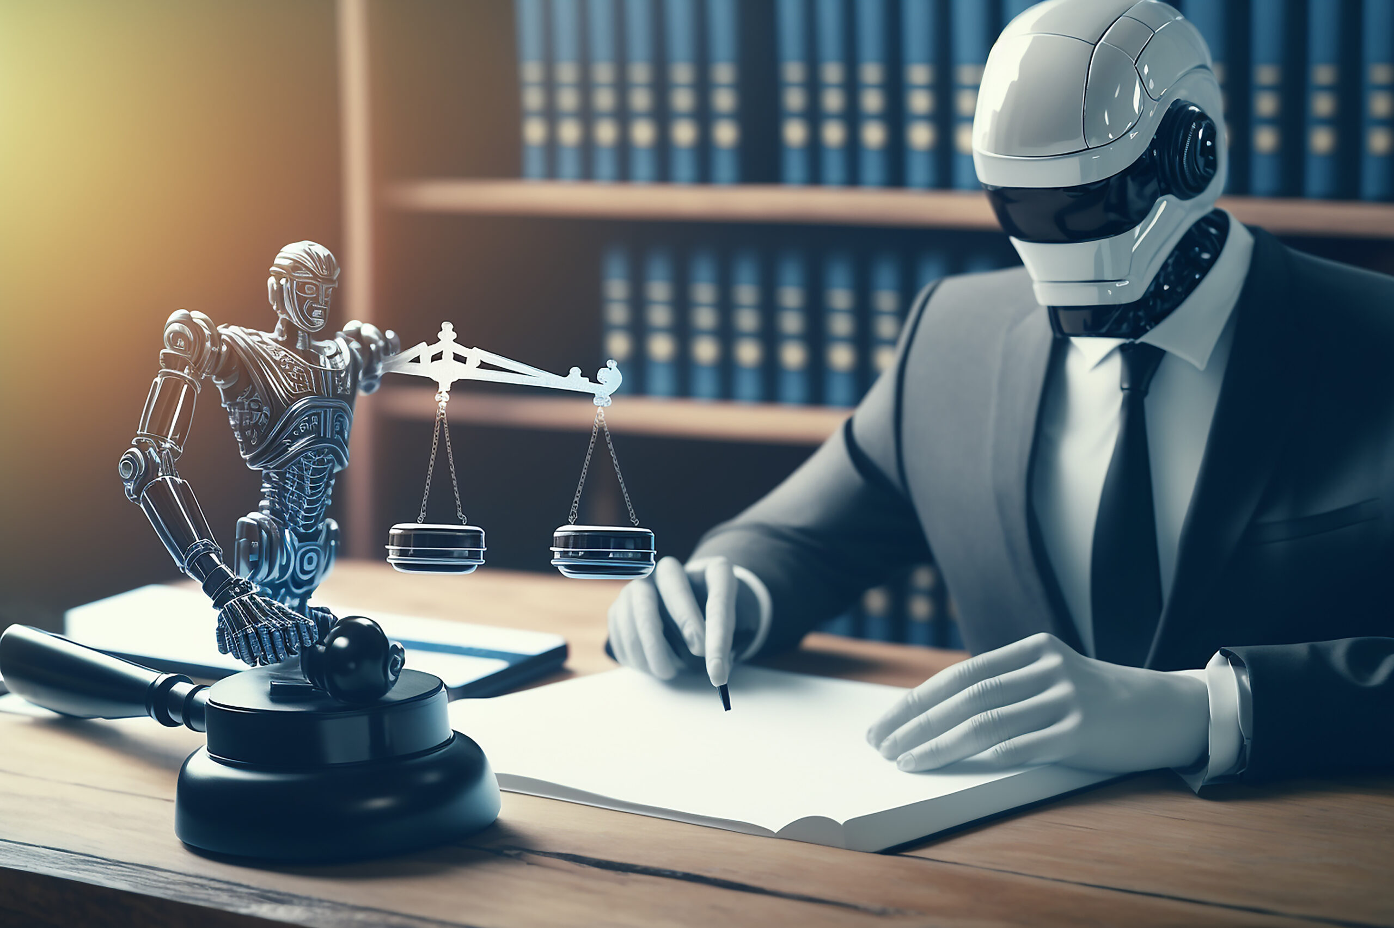
Use of AI to Win Nuclear Verdicts
Predictive Case Selection​
  Analyzes critical trends, behaviors, and historical outcomes​
  Identifies high-value cases with potential for large damages
Jury Psychology & Narrative Testing​
  Simulates trial outcomes and emotional responses​
  Optimizes arguments using psychological tactics like anchoring
Evidence Analysis & Discovery​
  Automates document review to uncover key facts and inconsistences
  Speeds up case preparation and strengthens claims
Juror Profiling​
  Uses sentiment analysis and public data to tailor messaging
  Enhances emotional resonance with jury members
33

Slide 35
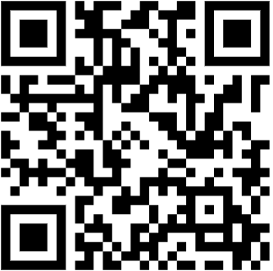
Questions?
Jeanne E. Walker
VP and Special Counsel
U.S. Chamber of Commerce Institute for Legal Reform
jwalker@uschamber.com
Visit our Website!
34

